Slide 1
Olympics Database
Avdhoot Jadhav
February, 2021

Slide 2

Problem statement
Olympics = Mecca of sports
10,000 participants
2012 London Olympics Record viewership
Marketing revenues:
2012 : $8 billion
2016 : $7.7 billion
2021: Japan committed $13.7 billion
Organizing the sport extravaganza :
Management of huge data
Statistics of every sport - popularity, growth
Partnering sponsors with appropriate sports

Slide 3
ERD
Entity Relationship Diagram

Slide 4
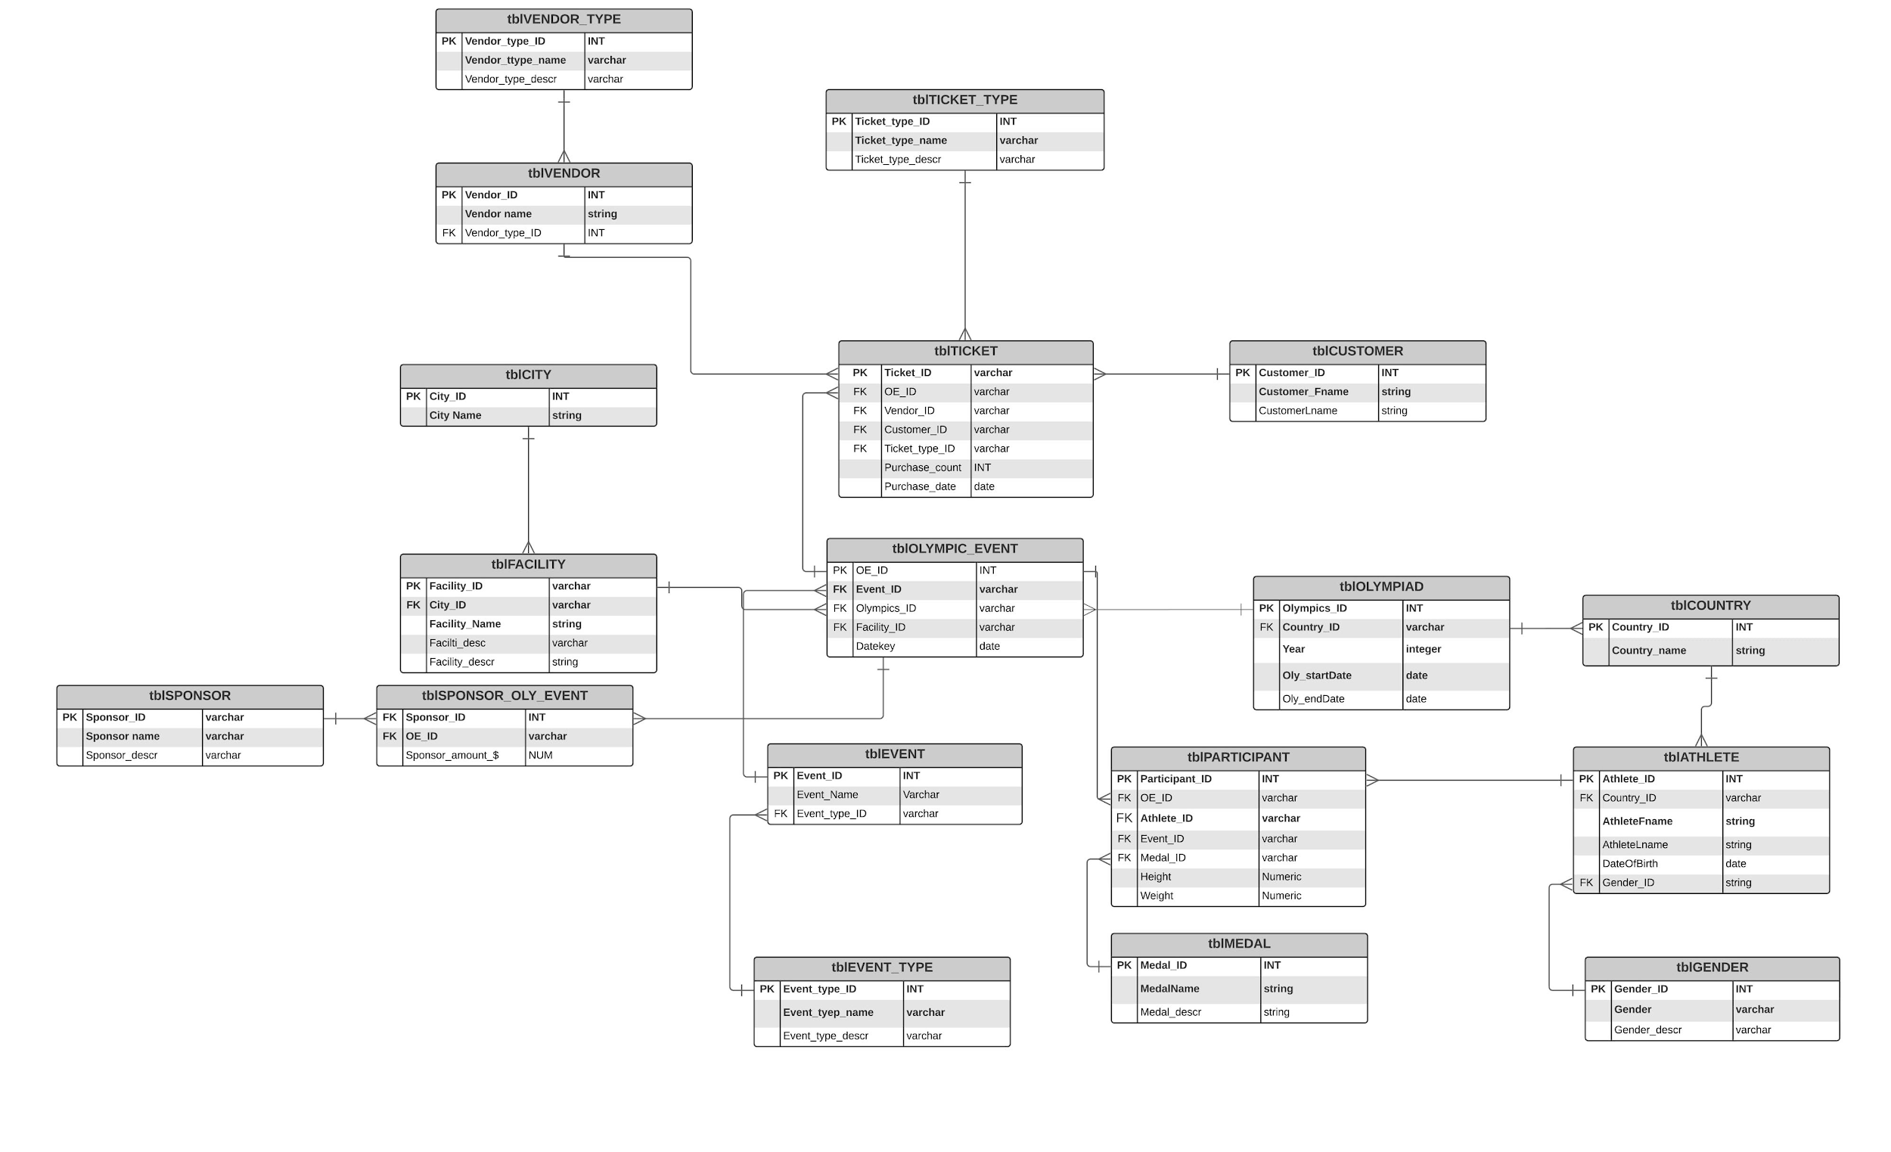

Slide 5
Tables populating
9 Look-up tables : Medal, Country, Customer
9 Transactional tables : Olympic, Participant, Olympic event
INSERT INTO lookup tables : stored procedures & source rows from PEEPS/University
INSERT INTO transactional tables : nested stored procedures with getID()

Slide 6
Business rules and computed columns
Number of tickets one customer can buy {limit 10}
Age of a participant {21 and above only}
Number of tickets - grouped by ticket type: Digital/Physical
Count of times a customer made a purchase; not the number of tickets bought

Slide 7
Things we can improve
Current design
Modifications
Individual events only
Stadiums can host one event
- Team events as well
- Stadiums to event multiple events at the same time
- World and olympic records for every event

Slide 8
Data Visualization
Athlete count per country and medals tally
Sponsorship details per event
Ticket sales per event

Slide 9
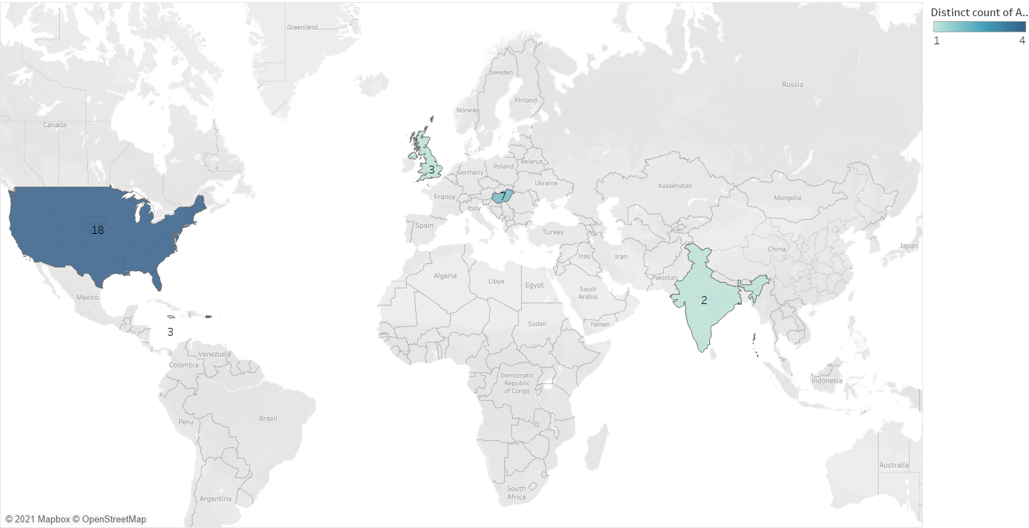
Athlete count and medal tally

Slide 10
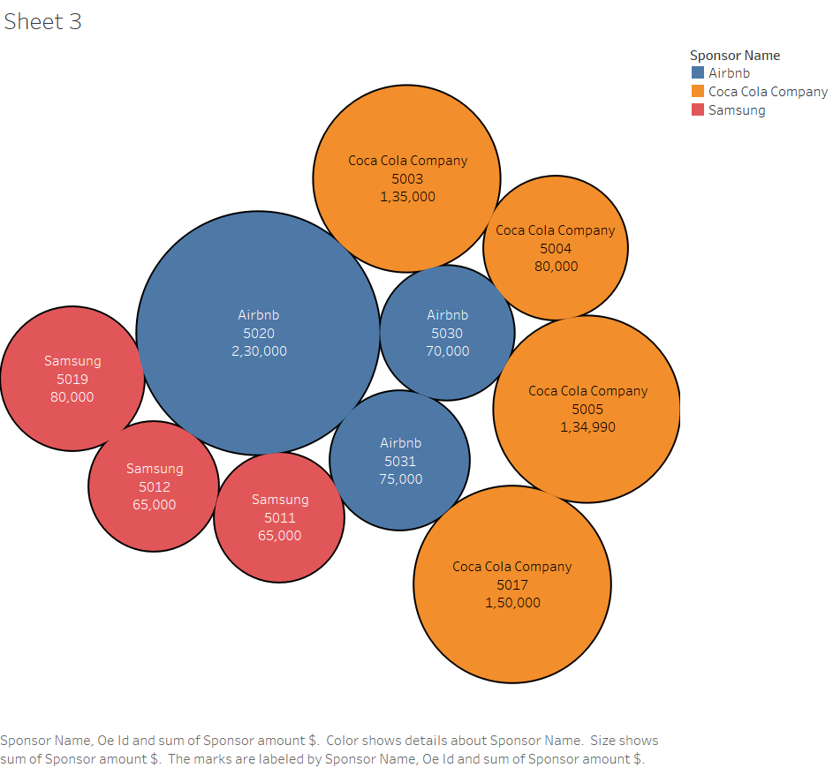
Sponsorship details and amount

Slide 11
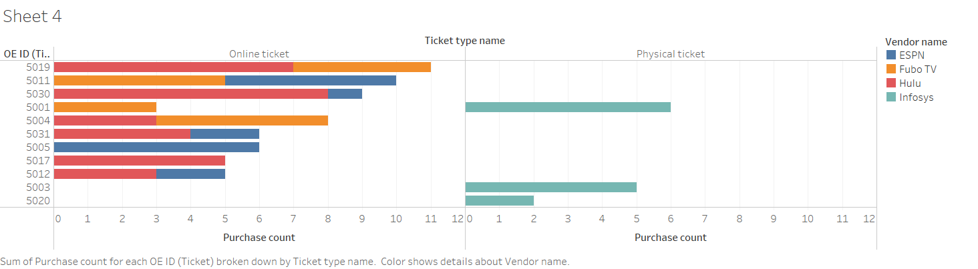
Ticket Sales

Slide 12
Thank you
Avdhoot Jadhav
jadhavavdhoot7@gmail.com

